Slide 1





HackOrbit 2025
WEBWIZARDS
“Your Wealth, Our Code”

Slide 2

THEME & PROBLEM STATEMENT
Theme – FinTech Innovation
“WE TURNS CONFUSION INTO CONFIDENCE – ALL IN ONE DASHBOARD!”
In today’s rapidly evolving Fin-Tech landscape, retail investors and aspiring traders often lack access to simple, real-time, and insightful stock market data. Existing platforms are often complex, technical, or hidden behind paywall making it hard for beginners and non-finance users to analyze stocks and make confident investment decision .

Slide 3
PROPOSED SOLUTION
📌We propose a web-based portfolio management platform where users can :-
📊Develop a Simplified Stock Analysis Platform
Create a user-friendly website or app that presents stock data in a clear, visual, and intuitive format.
📊Use Free and Open APIs
Integrate reliable APIs (like Alpha Vantage, Finnhub, or Yahoo Finance) to provide real-time stock prices and historical data without licensing costs.
📊Design for Beginners
Include a Beginner Mode, tooltips, and visual aids to explain complex financial terms and metrics.

Slide 4
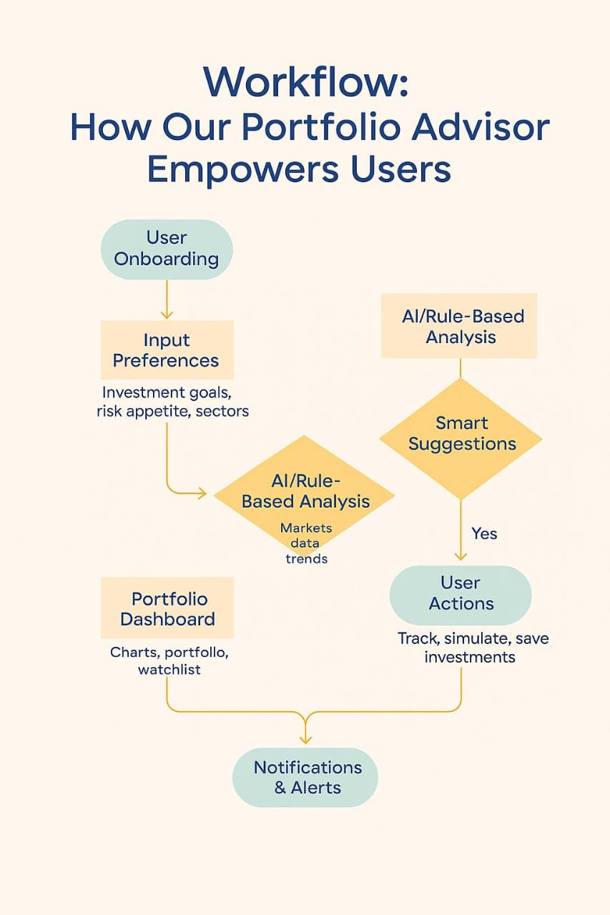
FLOWCHART

Slide 5
FLOWCHART / DIAGRAM
Explanation
This flowchart describes an overview of the overall flow of our FinTech platform. The users start by signing up and specifying their preferences. Our platform then consumes real-time market data, applies intelligent rule-based or AI analysis, and advises personalised investment recommendations. All activity can be seen on a clean portfolio dashboard and you receive real time alerts for important market movements.
“We don’t just show data – we turn it into decisions.”
.

Slide 6
FEATURES AND NOVELTY
📈 Real-Time Stock Data Access
Offers up-to-date prices, charts, and company info using APIs (e.g., Alpha Vantage, Yahoo Finance).
📈 Beginner-Friendly Interface
Simple, clean UI tailored for non-finance users with tooltips, color-coded indicators, and jargon-free insights.
📈 Watchlist and Alerts
Lets users save their favorite stocks and get notified of key price movements.
📈 Financial Literacy Integration
In-app content (blogs, tips, videos) to educate users about basic investing and stock market principles.
📈 Responsive Web Design-
Works smoothly across desktop, tablet, and mobile devices for greater accessibility.

Slide 7
DRAWBACKS AND SHOWSTOPPERS
🚫DRAWBACKS :-
1. Too Complex
Technical jargon and complex charts that intimidate beginners.
2. Paywall Restrictions
Many key features are locked behind subscriptions.
3. Poor UX
Platforms are often not mobile-friendly or optimized for casual users.
❌SHOWSTOPPERS :-
1. API Dependency
Relying on free API’s(like Alpha Vantage)may hit rate limits.
2. Security Alerts
If not handled well, stock alerts & user data can be exposed.
📌These Limitations open the door for a more intuitive, personalized and beginner-friendly platform like ours.

Slide 8
TEAM NAME
“WE’RE WEBWIZARDS, TURNING CODE INTO WEALTH”
Aadarsh Jain - 9302639757
Chahat Bhatija - 8965808403
Ashish Garg - 9039047479
Adish Jain - 9098769822

Slide 9
Thank you

